Slide 1
Predictive Maintenance in Semi-conductor Industry
Athuljith M
16DVSAC006

Slide 2
abstract
Semiconductor manufacturing is one of the most technologically and highly complicated manufacturing process.
Our strategy would be to perform Data Cleaning followed by Feature Selection to preserve only most relevant signals. We would then propose machine learning techniques and generate an accurate predictive model to predict equipment faults.
This research paper aims at constructing a decision model to help detecting as quickly as possible any equipment faults in order to maintain high process yields in manufacturing.

Slide 3
Existing system and limitations
Traditional machine learning algorithms such as uni-variate and multivariate analyses have long been deployed as a tool for creating predictive model to detect faults.
In this paper we review some of these research areas and thus propose machine learning techniques to automatically generate an accurate predictive model to predict equipment faults during the wafer fabrication process of the semiconductor industries.

Slide 4
Hardware and software requirements
Hardware Requirements:
RAM :- 8GB and above
Processor :- Intel core i5 and above
Disk Space :- 2GB
Active Internet Connection
Software Requirements:
R Programming 3.6
R Studio

Slide 5
Framework
Brief overview of work done in Task I
Brief overview of work done in Task 2:

Slide 6
Model Overview
Data Understanding | Data Pre-Processing Phase | Data Modeling Phase | Predictive Model Evaluation
Data Cleaning
Modelling Induction Methods
Data Cleaning
Prediction Model
Original data;
1567 instances and 591 attributes
Model Evaluation
Feature Selection
Boosting Technique
Evaluation Results

Slide 7
Brief Review of Work done in task I
Data Understanding
R Script for downloading data files/labels from source.
Percentage of missing values in each Row/Column.
Missing Value Visualisation

Slide 8
Brief overview of task ii
Removal of variables with >55% NA
Removal of variables with 0 Variance.
Scaling
Imputation using KNN
Normalisation
Feature Selection- We analysed PCA, Baruta and chose Baruta
Predictive Model Evaluation

Slide 9
OVERVIEW
Task 1
Task 2
Task 3
Data Understanding
Removal of features having rows with >55% NAs
Find the best approach to deal with imbalances in the data.
Removal of variables with zero Variance.
Percentage of missing values in each Row/Column
Implement various models based upon classification performance measures such as sensitivity, specificity, accuracy and error rate.
Imputed data using K Nearest Neighbour method.
Missing Value Visualisation
Normalised data in the range -1 to 1
Valuable Insights from various case studies.
Assess the quality of models using confusion matrix.

Slide 10
Introduction to Data
Dataset File
1567 examples each with 590 features
Two Files
Data frame combining two files
classifications and date time stamp for 1567 examples
Labels File

Slide 11
Data Cleaning
Original Data
Removal of variables with more than 55% of NAs
Removal of variables where Variance = 0
Cleaned Data
Step 1
Step 2
Reduced from 592 to 568
Reduced from 568 to 451

Slide 12
Removing Variables having >55% of NAs
We removed all the Variables having >55% of NAs. So, the number of variables were reduced from 592 to 568 i.e a drop of 24.

Slide 13
Removing Variables with Zero Variance
We removed all the Features having Zero variance. So, the number of variables were reduced from 568 to 452 i.e a drop of 116.

Slide 14
Various Imputation Approaches
Imputation methods
1) Mean
2) K-nearest neighbours (KNN),
3) Fuzzy K-means (FKM)
4) singular value decomposition (SVD)
5) Bayesian principal component analysis (BPCA)
6) Multiple imputations by chained equations (MICE)

Slide 15
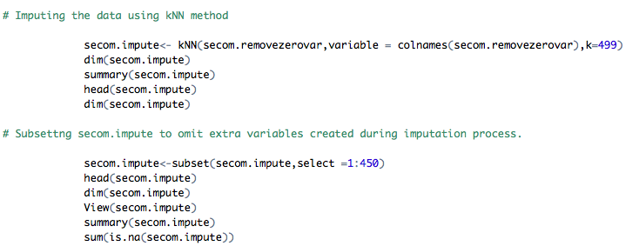
kNN Imputation Method

Slide 16
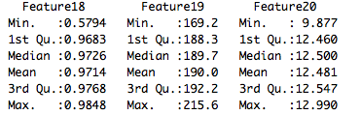
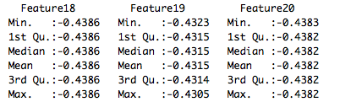
Data Normalisation
Approach: Used Min – Max function to Standardize the value in the range from -1 to 1
Purpose: To change the values in the dataset to a common scale, without distorting differences in the ranges of values.
Before
After

Slide 17
Overview Of Task 3
Dealing with Imbalances in Data
Comparison of various Predictive model
Selecting the Best Statistical Model based on various parameters

Slide 18
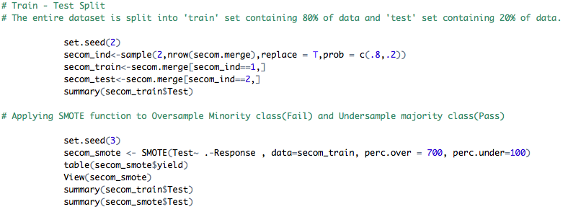
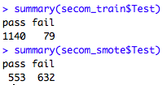
Dealing with Imbalanced Data
Step 1: Splitting the Dataset into Parts. ‘Train Set’ having 80% of data and ‘Test Set’ having 20% of the data.
Step 2: Applying ‘SMOTE’ Function to Oversample Fail test set and Under sample Pass test set.

Slide 19

Minority Sampled boosting using SMOTE
Smote is synthetic minority over sampling. In our data, there are very less fail cases compared to pass cases. So we had to reduce the pass cases and increase the fail cases.
Smote is used for this sample balancing.

Slide 20
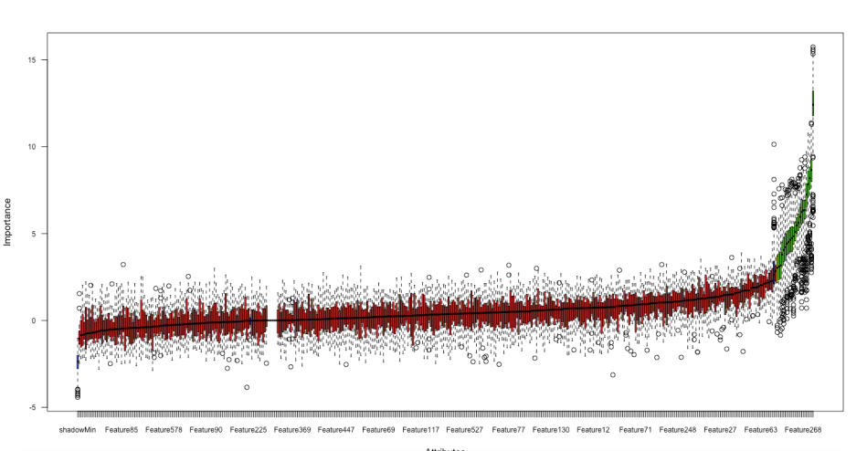
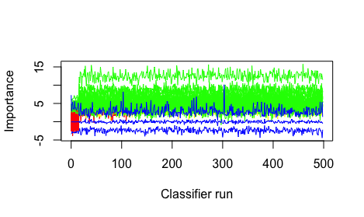
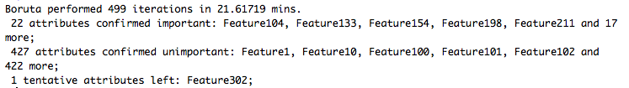
Feature Selection with Boruta

Slide 21
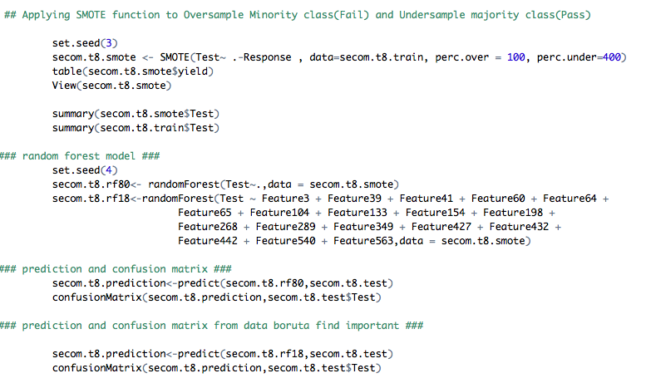
Feature Selection Approaches
1) Boruta (continued..)

Slide 22
Comparison of various Statistical Models
Models | Prediction Accuracy (%) | Sensitivity (%) [% of Fail class] | Specificity (%) [% of Pass class]
Decision Tree | 71.34 | 14.28 | 75.42
Random Forest | 89.66 | 94.74 | 24.00
Naïve Bayes | 86.62 | 14.28 | 91.80
kNN | 75.16 | 28.57 | 78.49

Slide 23
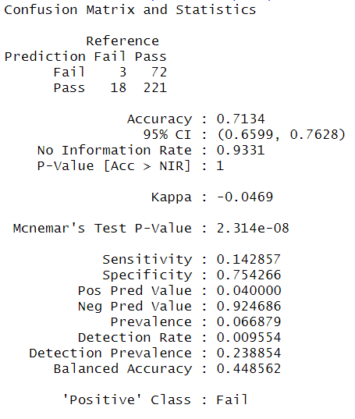
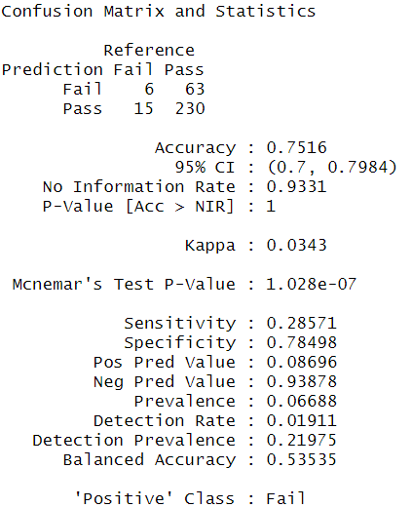
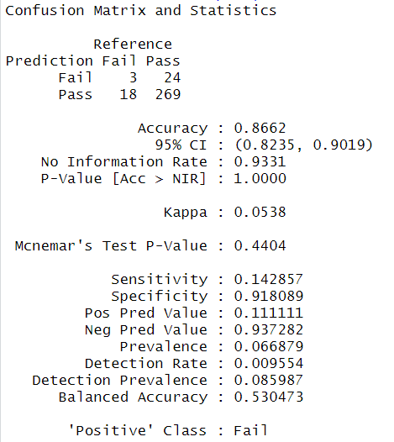
Confusion Matrices of various Statistical Models
Decision Tree Model
kNN Model
Naïve Bayes

Slide 24
R - Random Forest
In the random forest approach, a large number of decision trees are created. Every observation is fed into every decision tree. The most common outcome for each observation is used as the final output. A new observation is fed into all the trees and taking a majority vote for each classification model.

Slide 25
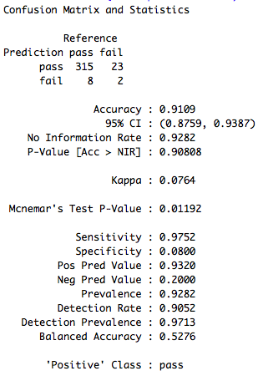
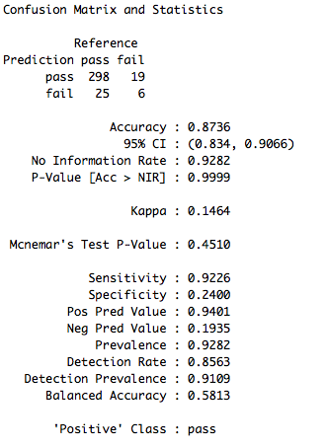
Results for Random Forest using all variables
All Variables
Confirmed Variables

Slide 26
Summary
During the course of the project, first we did the Data Cleaning, then we imputed the rest of the missing value using kNN method, followed by normalizing the variables in a range from -1 to 1.
Further, we worked upon various feature selection methods and finalized Boruta as our feature selection technique.
In the next phase, we boosted our ‘fail’ test cases and then applied various Statistical Models and finalized Random Forest Model.
However, our accuracy was 87.36%. By using Grid Search, we tuned the model and achieved an accuracy of 89.66%

Slide 27
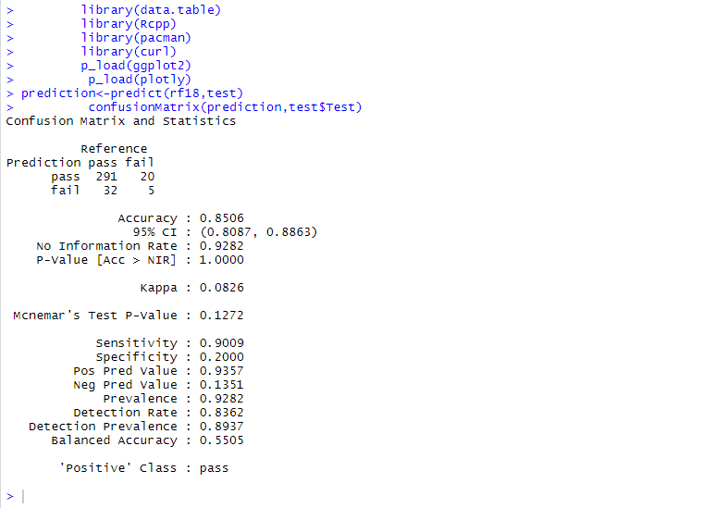
Screenshots

Slide 28
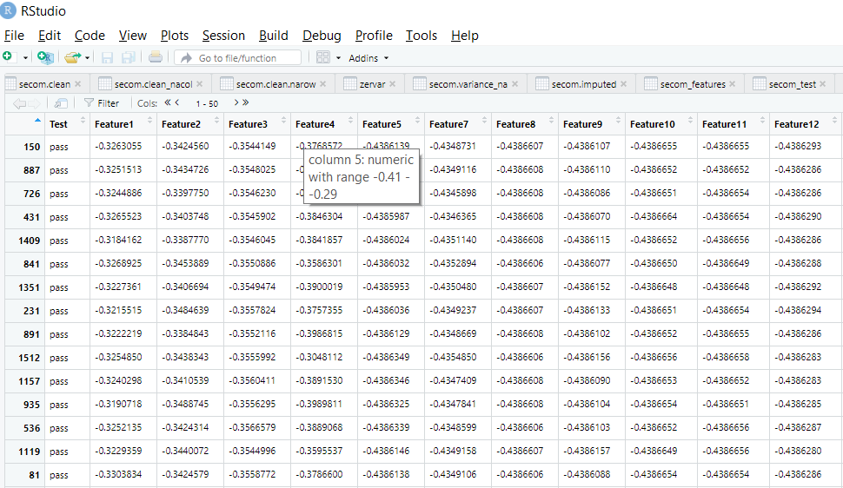
Screenshots

Slide 29
Conclusion
The semiconductor industry is one of the most capital- intensive industries with a high of capital investment on equipment’s. Optimization of manufacturing equipment’s has received significant attention and shown to be a necessary competitive advantage. There are exciting challenges and opportunities for the engineers and researchers to develop a new standard for this vigorously growing industry. A good classification prediction model is beneficial for the prediction in semiconductor manufacturing fabrication process. Most semiconductor manufacturing is highly complex and has produced constantly hundreds of metrology data that are awaiting for process engineers to analyze for the purpose of maintaining efficient operations and getting optimum yield of high quality products. For such a large volume of measurement data, automatic data analysis technique such as data mining is essential.

Slide 30
Thank You

